Slide 1

NOIP Basic Algorithms
August 26 , 2018​​
Note: Please turn off your microphone and camera.
Mr. Gao's Algorithm
Competition Training Camp

Slide 2
recursive functions
Note: Please turn off your microphone and camera.
Mr. Gao's Algorithm
Competition Training Camp

Slide 3
Recursion in daily life
This is the song that doesn't end Yes, it goes on and on, my friend Some people started singing it not knowing what it was, And they’ll continue singing it forever just because…
This is the song that doesn't end Yes, it goes on and on, my friend Some people started singing it not knowing what it was, And they’ll continue singing it forever just because…
This is the song that doesn't end Yes, it goes on and on, my friend Some people started singing it not knowing what it was, And they’ll continue singing it forever just because…
What are the characteristics of this song?
When will the song end?

Slide 4
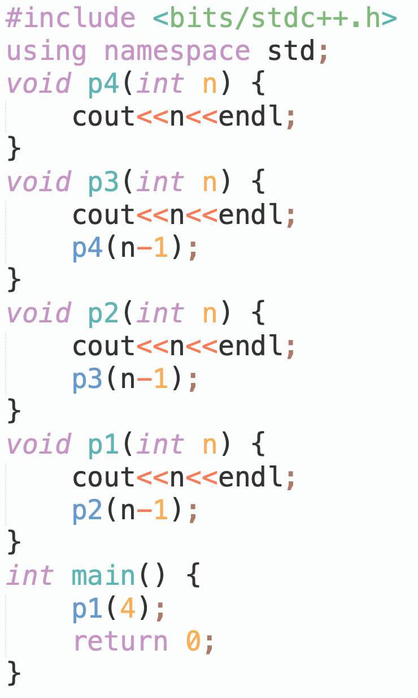
Example 1
Output:
4 3 2 1

Slide 5
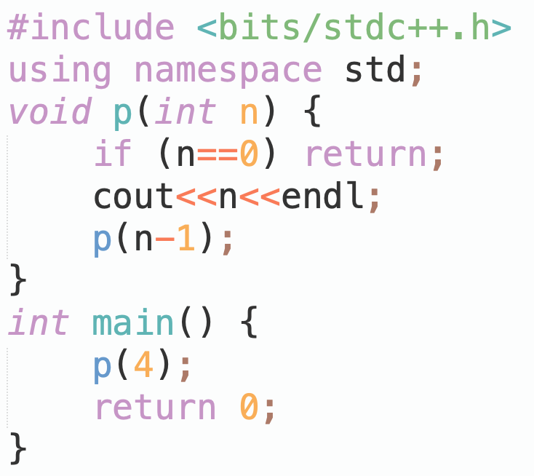
Example 1
When a function body contains a statement that calls itself, it is called recursion.
How to output 1 2 3 4 instead?

Slide 6
What is a recursive function?
A function that calls itself directly or indirectly.
The two main elements of a recursive function:
Recursive case(s): A description of a problem in a recursive form.
Base case(s): should be treated as a special case, rather than using the recursive case.
Two pre-requisites for problems to be solved recursively:
It is possible to transform the problem into a new problem, and the solution to the new problem is exactly the same as that to the original, only the size of the input different.
There is a clearly defined base case.

Slide 7
The execution of a recursive function
The execution of a recursive function always occurs before one function body has finished executing. The function takes the result of the current execution and enters another round of function body execution, and so on, going deeper and deeper, until the execution of a function encounters the boundary condition for terminating the recursion . At this point, it stops going deeper and executes the remaining part of the function body for the current call, and then returns to the function body of the previous call to execute the remaining part, and so on, until it returns to the starting position, and finally ends the execution of the entire recursive function and obtains the corresponding execution result.
Func A
Func A
Func A
Func A
Start
Terminate?
N
Call A
Terminate?
N
Call A
Terminate?
N
Call A
Terminate?
Y
Return
End

Slide 8
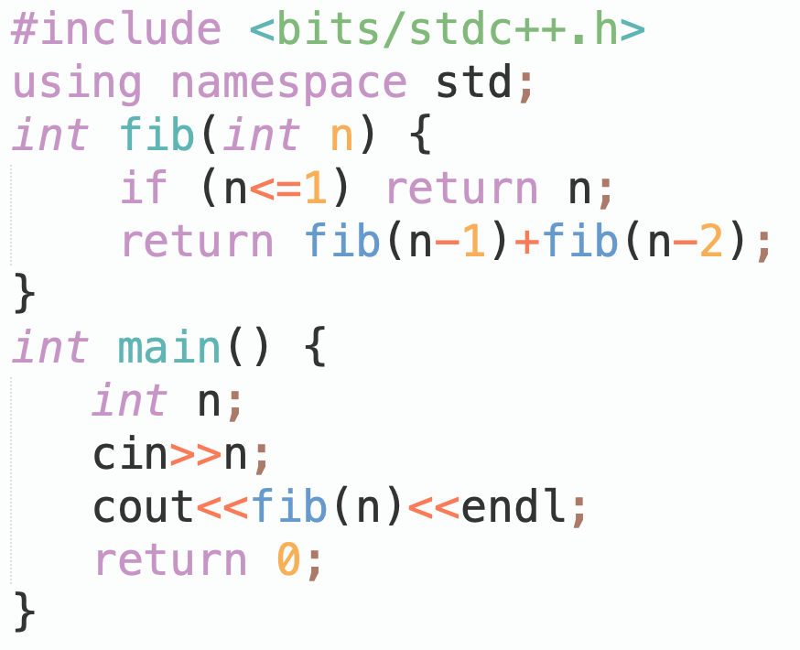
The execution of a recursive function
If a recursive function calls itself more than once, then the entire execution process of the recursive function can be viewed as a recursive call tree.
main()
call
return
fib(4)
call
return
return
call
fib(3)
fib(2)
call
return
call
return
return
call
return
call
fib(2)
fib(1)
fib(1)
fib(0)
call
return
return
call
fib(1)
fib(0)

Slide 9
The execution of a recursive function
Recursive functions typically have local variables ( such as 'n' in this example ) . These local variables only become meaningless after the entire function body has finished executing. Each recursive call must generate a new set of local variables. Although these new local variables have the same names as the original local variables, they are allocated different storage spaces and their values are completely unrelated.
P(4)->P(3)->P(2)->P(1)->P(0)

Slide 10
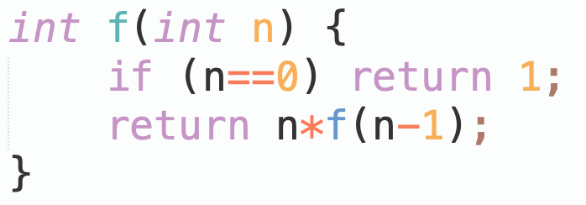

Practice Problem 1: Find n!
$f\left(n\right)$ = $n!$, then $f\left(n−1\right)$ =$(n−1)!$
Recursive case: $f\left(n\right)=f(n−1)∗n$
Base case: $n=0, f\left(0\right)=1$
Recursion cannot go on indefinitely.
Base case determines when to stop recursion.
Recursive case defines how to continue the recursive solution process.

Slide 11
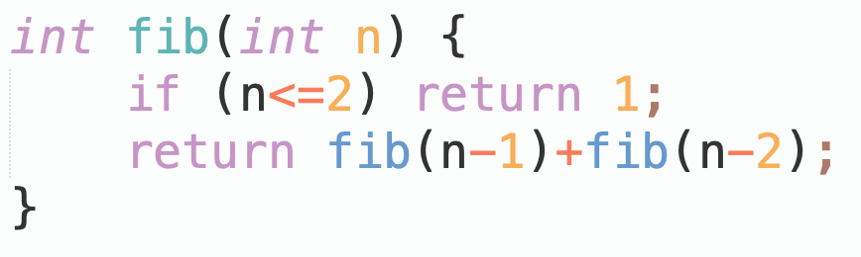

Practice problem 2: Recursive solution to the Fibonacci Sequence
The Fibonacci sequence: 1, 1, 2, 3, 5, 8, 13, 21, 34… Starting from the third element, each is the sum of the two preceding elements, i.e., $f\left(i\right)=f\left(i−1\right)+f(i−2)$
Try to find the $n$-th item recursively.
f(1)=1 n=1
f(2)=1 n=2
f(n) = f(n-1) + f(n-2) (n>2)

Slide 12
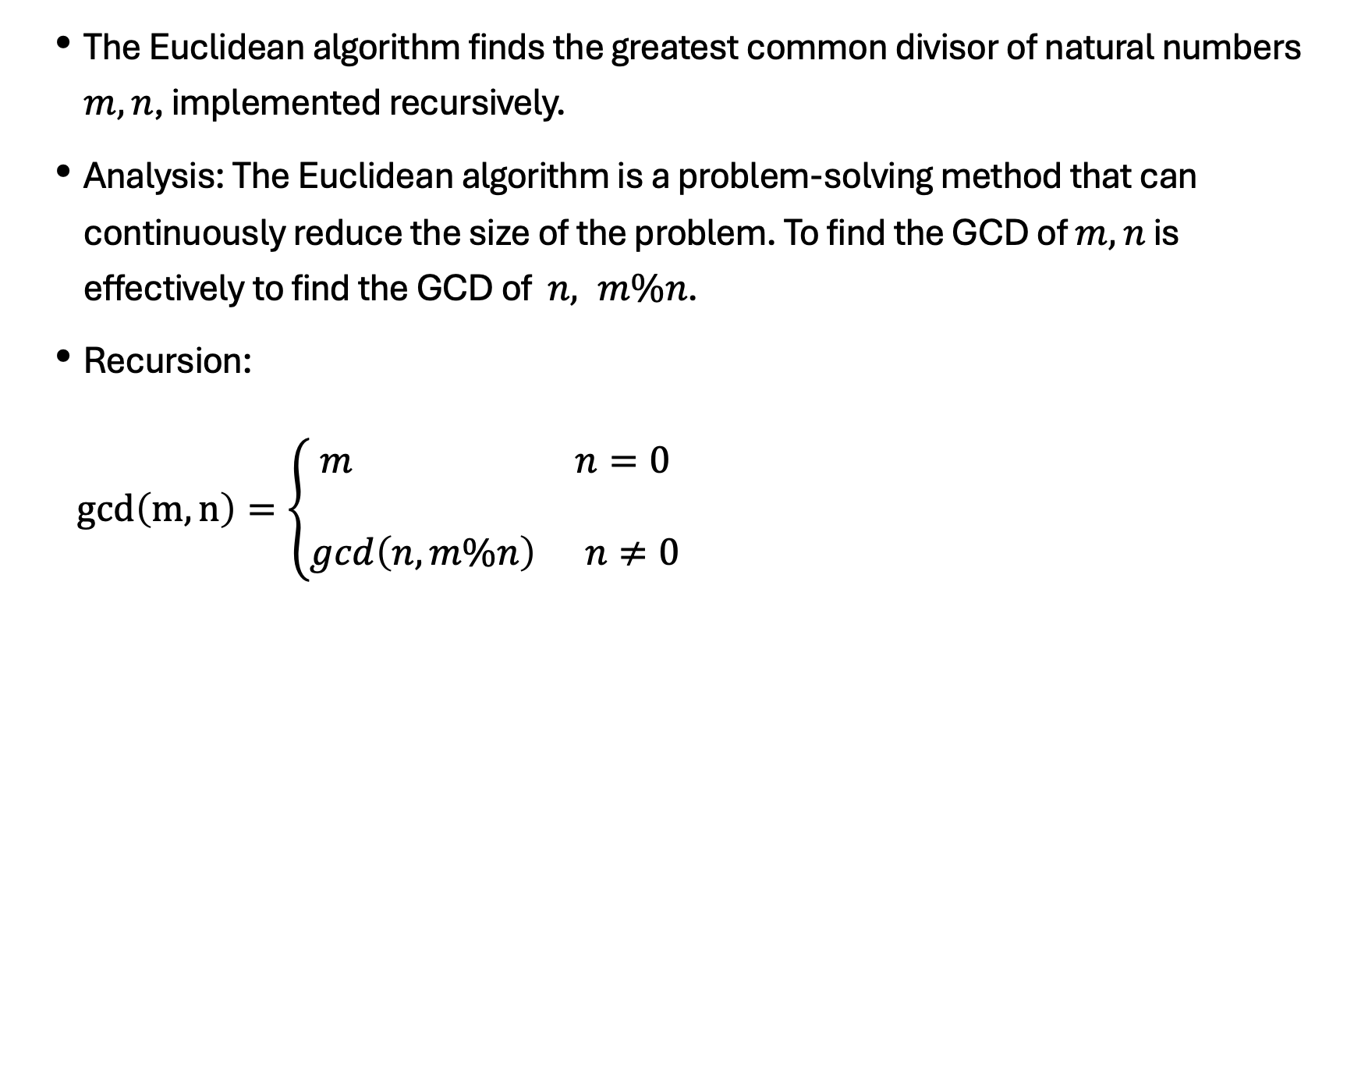
Practice problem 3: Euclidean Algorithm
The Euclidean algorithm finds the greatest common divisor of natural numbers $m, n$, implemented recursively.
Analysis: The Euclidean algorithm is a problem-solving method that can continuously reduce the size of the problem. To find the GCD of $m, n$ is effectively to find the GCD of $n, m\%n$.
Recursion:
$\gcd\left(m,n\right)=\left\{\begin{aligned}m n=0 \\ \\ \gcd\left(n,m\%n\right) n≠0\end{aligned}\right.$
m 45 35 10 5
n 35 10 5 0
m%n 10 5 0

Slide 13
Practice problem 4 : Number System Conversion
Convert a given decimal integer to binary and output the result.
#include <bits/stdc++.h>
using namespace std;
int print(int n){
if ( ){
print( );
cout << ;
}
}
int main(){
int n;
cin >> n; print(n); cout << endl;
return 0;
}
Input: 45
Output: 101101
Notes:
n>0
n/2
n%2

Slide 14
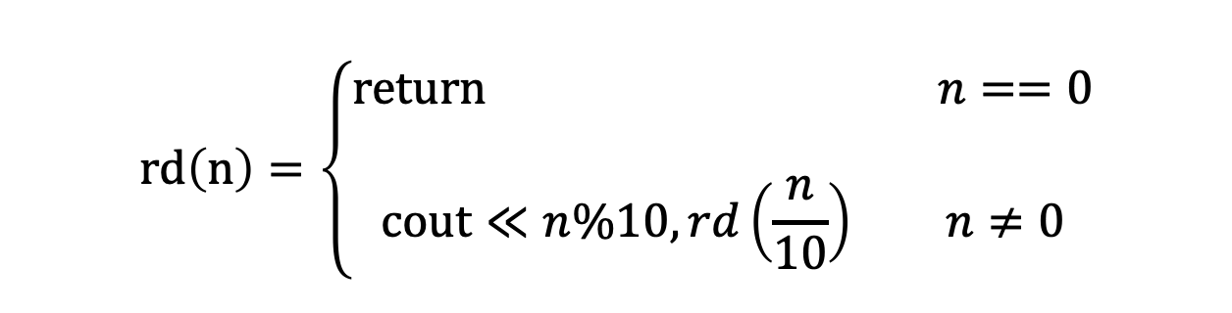
Practice Problem 5 : Number Reversal
Input a multi-digit number and output it in reverse order using a recursive method.
Analysis:
$$rd\left(n\right)=\left\{\begin{aligned}return n==0 \\ \\ cout≪n&\%10, rd\left(\frac{n}{10}\right) n≠0\end{aligned}\right.$$

Slide 15
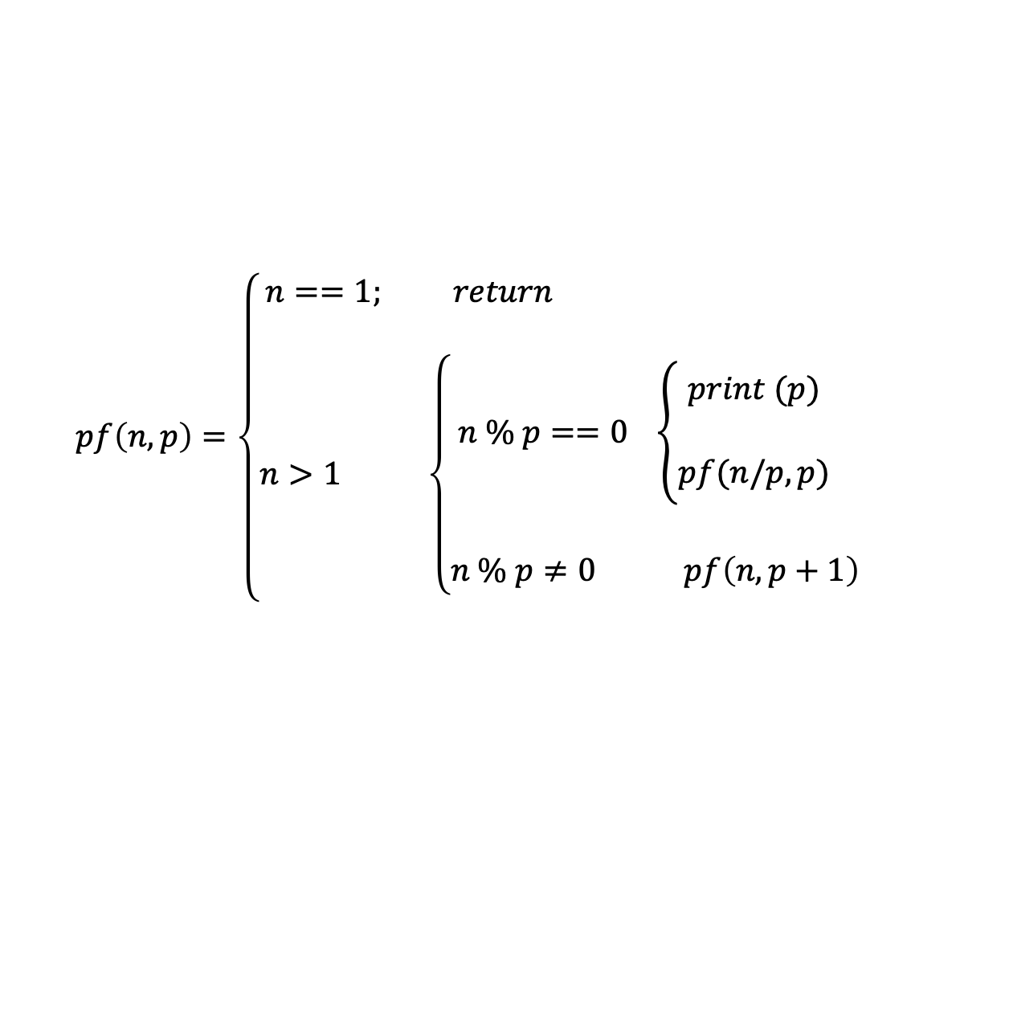
Practice problem 6 : Prime Factorisation
Given a positive integer n , output all its prime factors in ascending order using a recursive method.
Input example: 18
Output example: 2 3 3
$$pf\left(n,p\right)=\left\{\begin{aligned}n==1; return \\ \\ n>1 \left\{\begin{aligned}n \% p==0 \left\{\begin{aligned}print (p) \\ \\ pf(n/p,p)\end{aligned}\right. \\ \\ n \% p≠0 pf\left(n,p+1\right) \end{aligned}\right.\end{aligned}\right.$$

Slide 16
Practice problem 7 : KakuTANI Conjecture
A Japanese junior high school student discovered a fascinating theorem and asked Professor Kakutani to prove it. The professor was unable to do so, which led to the Kakutani Conjecture.
Given any natural number, if it is even, divide it by 2 ; if it is odd, multiply it by 3 and add 1. After obtaining a new natural number, continue the calculation according to the above rule. After a certain number of times, the result will always be 1 .
For example, for 22
22/2=11 11*3+1=34 34/2=17 17*3+1=52 52/2=26 26/2=13
13*3+1=40 40/2=20 20/2=10 10/2=5 5*3+1=16 16/2=8
8/2=4 4/2=2 2/2=1
Write a program to output the process until the result becomes 1.

Slide 17
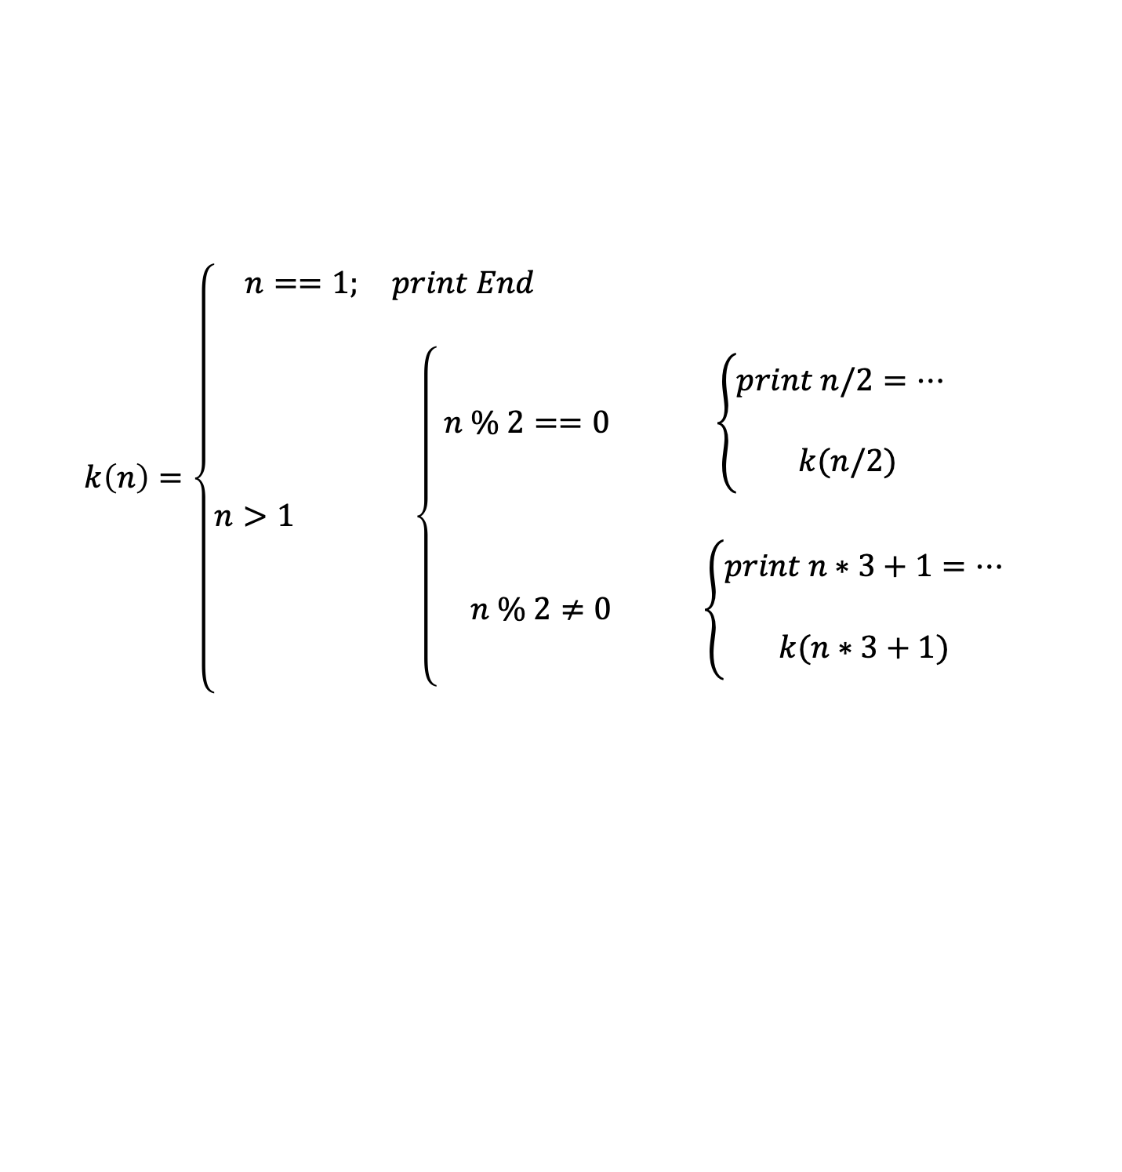
Practice problem 7 : Kakutani Conjecture
$$k\left(n\right)=\left\{\begin{aligned}n==1; print End \\ \\ n>1 \left\{\begin{aligned} n \% 2==0 \left\{\begin{aligned}print n/2=… \\ \\ k(n/2)\end{aligned}\right. \\ \\ n \% 2≠0 \left\{\begin{aligned}print n∗3+1=… \\ \\ k(n∗3+1)\end{aligned}\right.\end{aligned}\right.\end{aligned}\right.$$

Slide 18
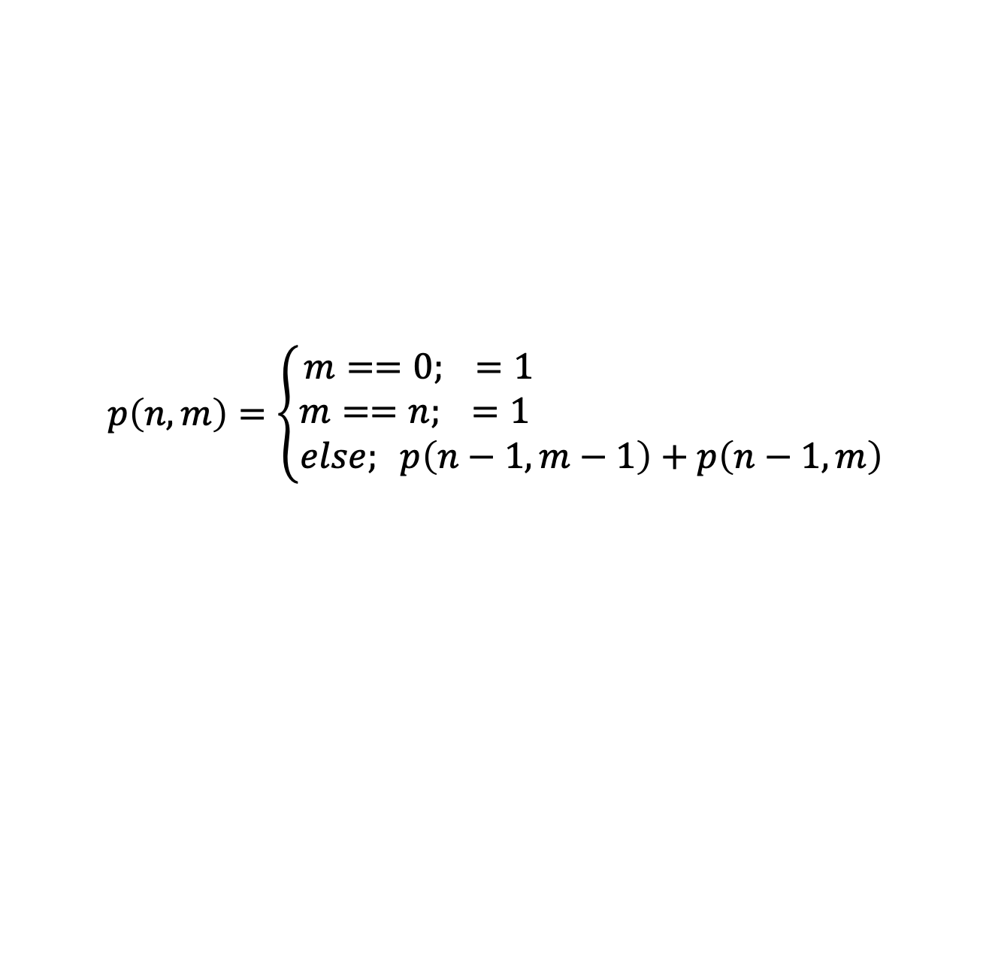
Practice problem 8 : Pascal's Triangle
The right figure is Pascal‘s triangle. Output the value on a particular row and column based on the row number and column number.
Input example: 4 2
Output example: 6
1
1 1
1 2 1
1 3 3 1
1 4 6 4 1
1 5 10 10 5 1
$$p\left(n,m\right)=\left\{\begin{aligned}m==0; =1 \\ m==n; =1 \\ else; p\left(n−1,m−1\right)+p\left(n−1,m\right) \end{aligned}\right.$$

Slide 19
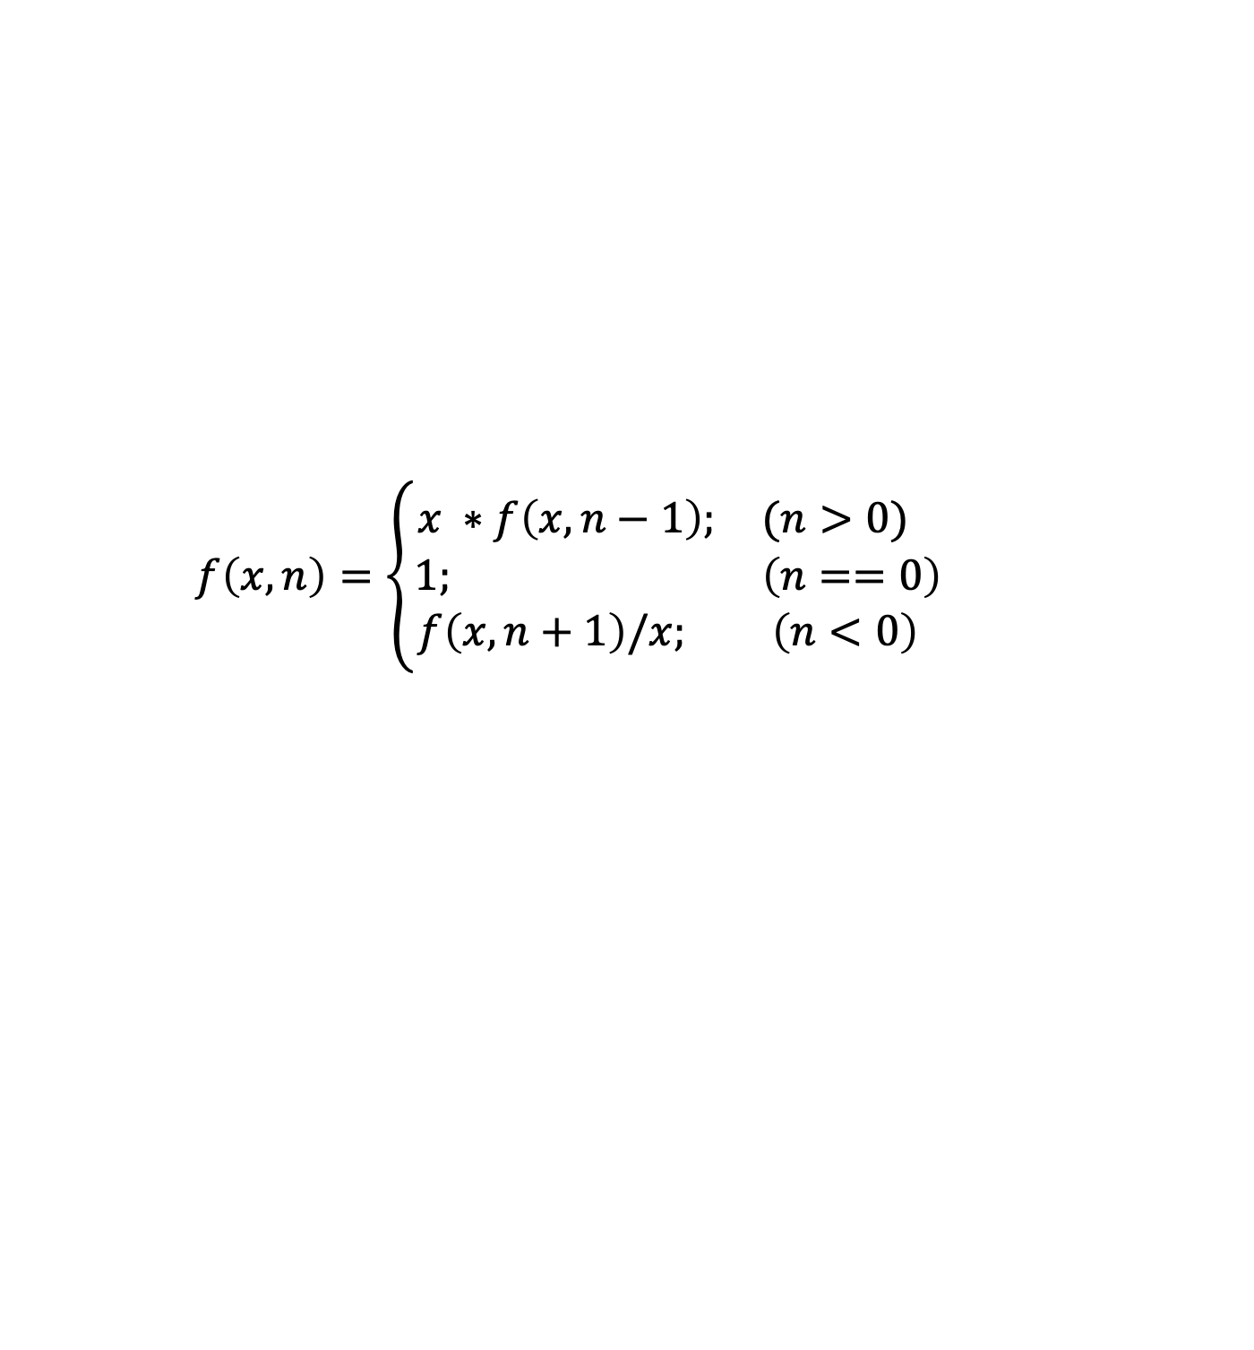
Practice problem 9 : Find x^{n}
x^{n} using a recursive method. (x != 0 , n is an integer )
Input example: 4 2
Output example: 16.00
$$f\left(x,n\right)=\left\{\begin{aligned}x ∗f\left(x,n−1\right); (n>0) \\ 1; \left(n==0\right) \\ f\left(x,n+1\right)/x; \left(n<0\right) \end{aligned}\right.$$

Slide 20
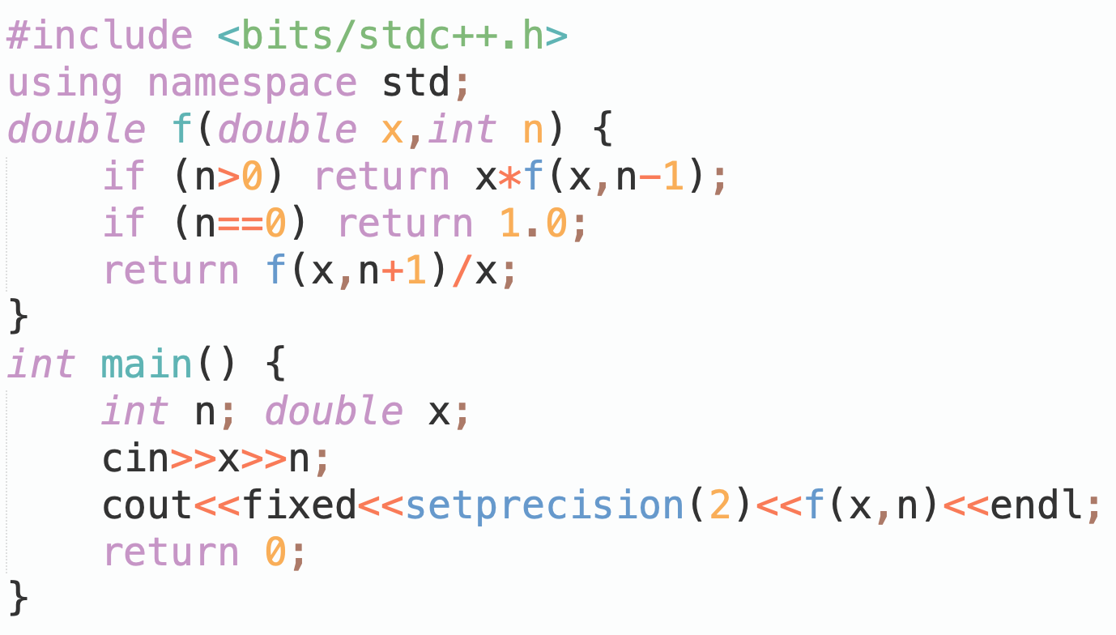
Practice problem 9 : Find x^{n}

Slide 21

Practice problem 10: Ackerman function
Ackman function is defined as follows:
$$ack\left(m,n\right)=\left\{\begin{aligned}n+1; (m==0) \\ ack(m−1,1); \left(n==0\right) \\ ack(m−1,ack\left(m,n−1\right)); else \end{aligned}\right.$$
Try to calculate the function value using recursion.

Slide 22
Practice problem 11 : Polish Notation
Polish notation, also known as prefix expression, is an arithmetic expression that places operators before the operands. For example, the Polish notation for 2 + 3 is + 2 3.
The advantage of Polish notation is that operators do not need to have precedence relationships, nor do they need to use parentheses to change the order of operations. For example, the Polish notation for (2 + 3) * 4 is * + 2 3 4.
In this problem you’ll evaluate a Polish notation, which includes the four operators: +, -, *, and / .
(2+3) * 4 + (3+5) / (2+6)
+ * + 2 3 4 / + 3 5 + 2 6
+ * + 2 3 4 / + 3 5 + 2 6
+ * + 2 3 4 / + 3 5 + 2 6

Slide 23
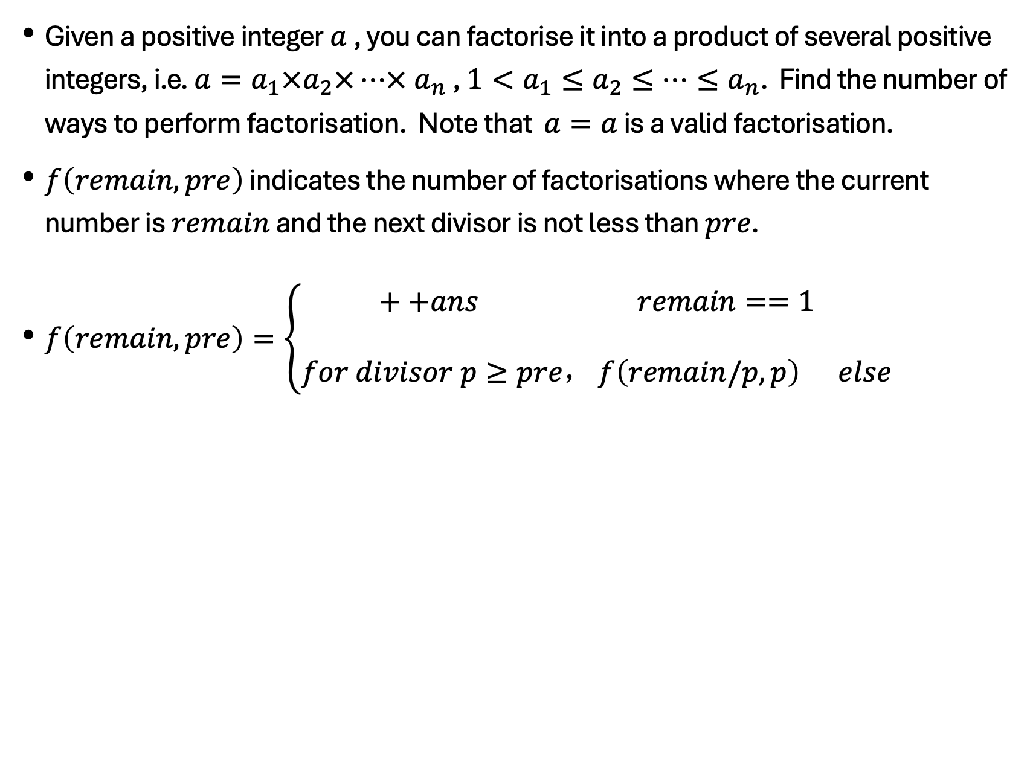
Practice Problem 12: Factorisation
Given a positive integer $a$, you can factorise it into a product of several positive integers, i.e. $a=a_{1}×a_{2}×…× a_{n}$, $1<a_{1}≤a_{2}≤…≤a_{n}$. Find the number of ways to perform factorisation. Note that $a=a$ is a valid factorisation.
$f\left(remain,pre\right)$ indicates the number of factorisations where the current number is $remain$ and the next divisor is not less than $pre$.
$f\left(remain,pre\right)=\left\{\begin{aligned}++ans remain==1 \\ \\ for divisor p≥pre，f\left(remain/p,p\right) else\end{aligned}\right.$

Slide 24
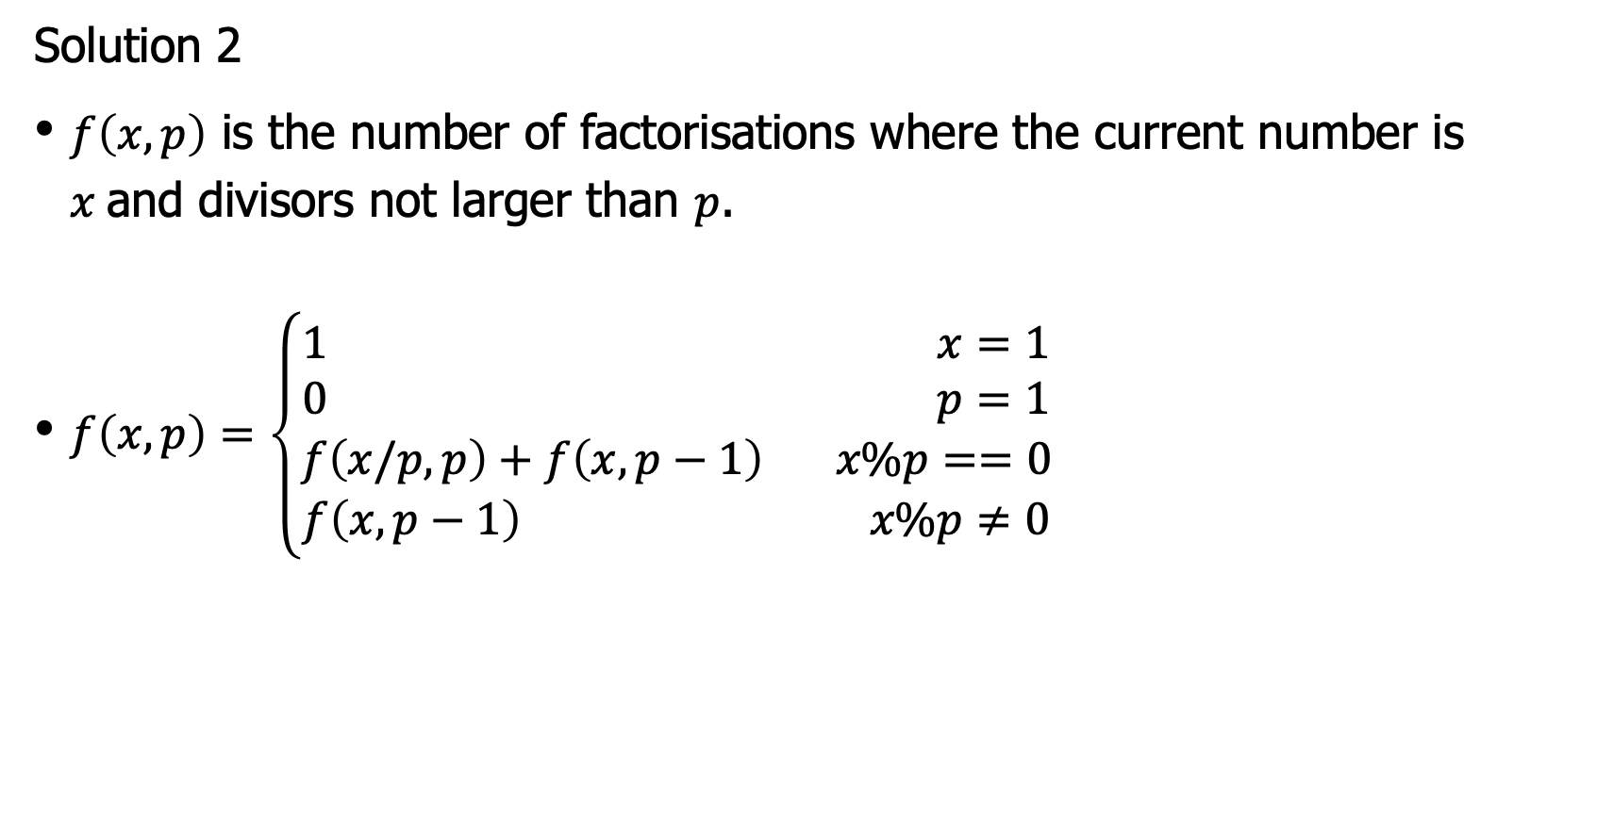
Practice problem 12: Factorisation
Solution 2
$f\left(x,p\right)$ is the number of factorisations where the current number is $x$and divisors not larger than $p$.
$f\left(x,p\right)=\left\{\begin{aligned}1 x=1 \\ 0 p=1 \\ f\left(x/p,p\right)+f\left(x,p−1\right) x\%p==0 \\ f\left(x,p−1\right) x\%p≠0\end{aligned}\right.$

Slide 25
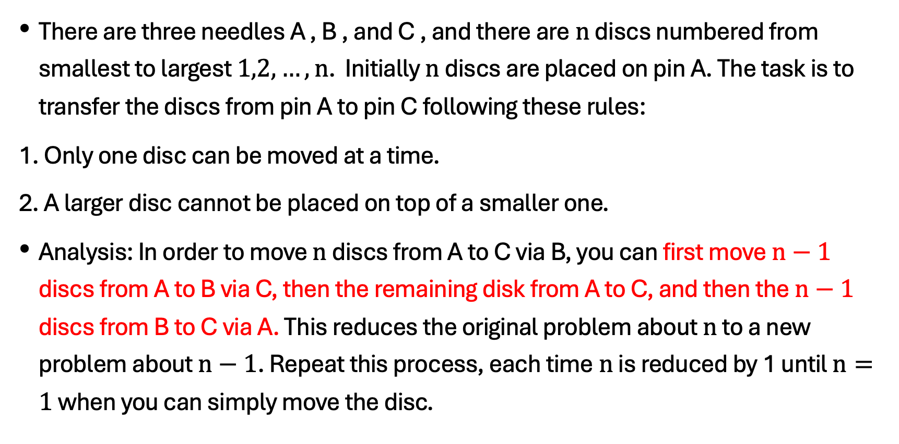
the Classic problem: The Tower of Hanoi
There are three needles A , B , and C , and there are$n$ discs numbered from smallest to largest $1,2,…,n$. Initially $n$ discs are placed on pin A. The task is to transfer the discs from pin A to pin C following these rules:
1. Only one disc can be moved at a time.
2. A larger disc cannot be placed on top of a smaller one.
Analysis: In order to move $n$ discs from A to C via B, you can first move $n−1$ discs from A to B via C, then the remaining disk from A to C, and then the $n−1$ discs from B to C via A. This reduces the original problem about $n$ to a new problem about $n−1$. Repeat this process, each time$n$ is reduced by 1 until $n=1$ when you can simply move the disc.

Slide 26
the Classic Problem: The Tower of Hanoi
Implementation of the Tower of Hanoi Problem
#include <bits/stdc++.h>
using namespace std;
void hanoi(int n, char a, char b, char c){
if ( ){
;
cout << a << " to " << c << endl;
;
}
}
int main(){
int n;
cin >> n;
hanoi(n, 'A', 'B', 'C');
return 0;
}
Notes:
n>0
hanoi (n-1,a,c,b)
hanoi (n-1,b,a,c);

Slide 27
Thank you everyone.
Note: Please turn off your microphone and camera.
Teacher Gao's Algorithm Competition Training Camp

Slide 28
NOIP Basic Algorithms
August 26 , 2018​​
Note: Please turn off your microphone and camera.
Mr. Gao's Algorithm
Competition Training Camp

Slide 29
recursive functions
Note: Please turn off your microphone and camera.
Mr. Gao's Algorithm
Competition Training Camp

Slide 30
Recursion in daily life
Once upon a time, there was a mountain, and on the mountain was a temple. In the temple, an old monk was telling a story to a young monk:
Once upon a time, there was a mountain, and on the mountain was a temple. In the temple, an old monk was telling a story to a young monk:
Once upon a time, there was a mountain, and on the mountain was a temple. In the temple, an old monk was telling a story to a young monk:
Once upon a time, there was a mountain, and on the mountain was a temple. In the temple, an old monk was telling a story to a young monk:
What are the characteristics of this story?
When will the story end?

Slide 31
Example 1
Output:
4 3 2 1

Slide 32
Example 1
When a function body contains a statement that calls itself, it is called recursion.
How to output 1 2 3 4 instead?

Slide 33
What is a recursive function?
A function that calls itself directly or indirectly.
The two main elements of a recursive function:
Recursive case(s): A description of a problem in a recursive form.
Base case(s): should be treated as a special case, rather than using the recursive case.
Two pre-requisites for problems to be solved recursively:
It is possible to transform the problem into a new problem, and the solution to the new problem is exactly the same as that to the original, only the size of the input different.
There is a clearly defined base case.

Slide 34
The execution process of a recursive function
The execution of a recursive function always occurs before one function body has finished executing. The function takes the result of the current execution and enters another round of function body execution, and so on, going deeper and deeper, until the execution of a function encounters the boundary condition for terminating the recursion . At this point, it stops going deeper and executes the remaining part of the function body for the current call, and then returns to the function body of the previous call to execute the remaining part, and so on, until it returns to the starting position, and finally ends the execution of the entire recursive function and obtains the corresponding execution result.

Slide 35
The execution process of a recursive function
If a recursive function calls itself more than once, then the entire execution process of the recursive function can be viewed as a recursive call tree.

Slide 36
The execution process of a recursive function
Recursive functions typically have local variables ( such as 'n' in this example ) . These local variables only become meaningless after the entire function body has finished executing. Each recursive call must generate a new set of local variables. Although these new local variables have the same names as the original local variables, they are allocated different storage spaces and their values are completely unrelated.
P(4)->P(3)->P(2)->P(1)->P(0)

Slide 37
Practice Problem 1: Find n!
$f\left(n\right)$ = $n!$, then $f\left(n−1\right)$ =$(n−1)!$
Recursive case: $f\left(n\right)=f(n−1)∗n$
Base case: $n=0, f\left(0\right)=1$
Recursion cannot go on indefinitely.
Base case determines when to stop recursion.
Recursive case defines how to continue the recursive solution process.

Slide 38
Practice problem 2: Recursive solution to the Fibonacci Sequence
The Fibonacci sequence: 1, 1, 2, 3, 5, 8, 13, 21, 34… Starting from the third element, each is the sum of the two preceding elements, i.e., $f\left(i\right)=f\left(i−1\right)+f(i−2)$
Try to find the $n$-th item recursively.
f(1)=1 n=1
f(2)=1 n=2
f(n) = f(n-1) + f(n-2) (n>2)

Slide 39
Practice problem 3: Euclidean Algorithm
The Euclidean algorithm finds the greatest common divisor of natural numbers $m, n$, implemented recursively.
Analysis: The Euclidean algorithm is a problem-solving method that can continuously reduce the size of the problem. To find the GCD of $m, n$ is effectively to find the GCD of $n, m\%n$.
Recursion:
$\gcd\left(m,n\right)=\left\{\begin{aligned}m n=0 \\ \\ \gcd\left(n,m\%n\right) n≠0\end{aligned}\right.$
m 45 35 10 5
n 35 10 5 0
m%n 10 5 0

Slide 40
Practice problem 4 : Number System Conversion
Convert a given decimal integer to binary and output the result.
#include <bits/ stdc ++.h>
using namespace std;
int print(int n){
if ( ){
print( );
cout << ;
}
}
int main(){
int n;
cin >> n; print(n); cout << endl;
return 0;
}
Input: 45
Output: 101101
Notes:
n>0
n/2
n%2

Slide 41
Practice Problem 5 : Number Reversal
Input a multi-digit number and output it in reverse order using a recursive method.
Analysis:
$$rd\left(n\right)=\left\{\begin{aligned}return n==0 \\ \\ cout≪n&\%10, rd\left(\frac{n}{10}\right) n≠0\end{aligned}\right.$$

Slide 42
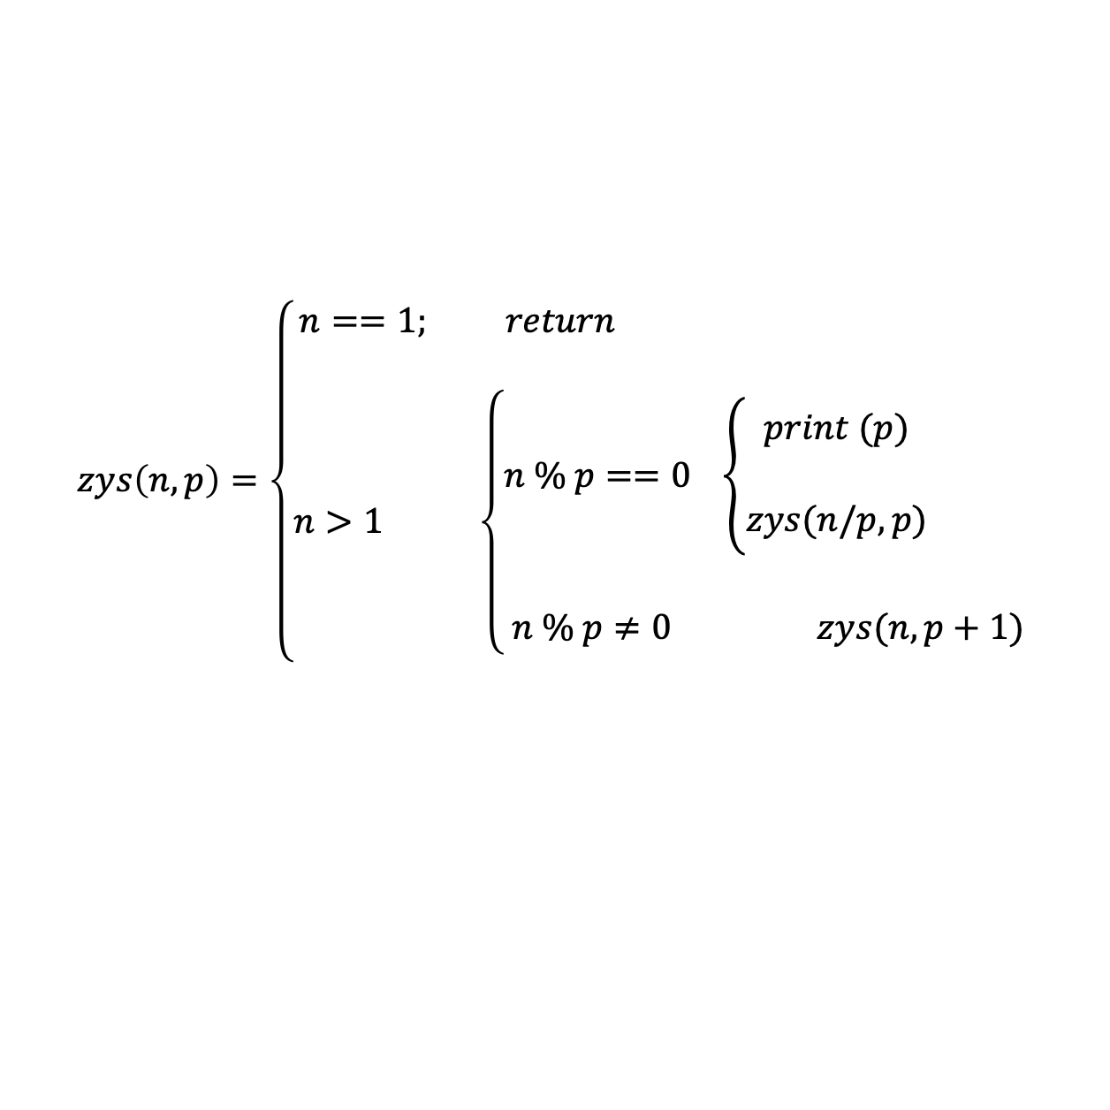
Practice problem 6 : Prime Factorisation
Given a positive integer n , output all its prime factors in ascending order using a recursive method.
Input example: 18
Output example: 2 3 3
$$zys\left(n,p\right)=\left\{\begin{aligned}n==1; return \\ \\ n>1 \left\{\begin{aligned}n \% p==0 \left\{\begin{aligned}print (p) \\ \\ zys(n/p,p)\end{aligned}\right. \\ \\ n \% p≠0 zys(n,p+1)\end{aligned}\right.\end{aligned}\right.$$

Slide 43
Classroom Example 7 : Kakugawa Conjecture
A Japanese junior high school student discovered a fascinating theorem and asked Professor Kakutani to prove it. The professor was unable to do so, which led to the Kakutani Conjecture.
Given any natural number, if it is even, divide it by 2 ; if it is odd, multiply it by 3 and add 1. After obtaining a new natural number, continue the calculation according to the above rule. After a certain number of times, the result will always be 1 .
For example, for 22
22/2=11 11*3+1=34 34/2=17 17*3+1=52 52/2=26 26/2=13
13*3+1=40 40/2=20 20/2=10 10/2=5 5*3+1=16 16/2=8
8/2=4 4/2=2 2/2=1
Write a program to output the process until the result becomes 1.

Slide 44
Practice problem 7 : Kakugawa Conjecture
$$k\left(n\right)=\left\{\begin{aligned}n==1; print End \\ \\ n>1 \left\{\begin{aligned} n \% 2==0 \left\{\begin{aligned}print n/2=… \\ \\ k(n/2)\end{aligned}\right. \\ \\ n \% 2≠0 \left\{\begin{aligned}print n∗3+1=… \\ \\ k(n∗3+1)\end{aligned}\right.\end{aligned}\right.\end{aligned}\right.$$

Slide 45
Classroom Example 8 : Pascal's Triangle
The right figure is Pascal's triangle. Output the value of the row and column based on the row number and column number.
Input example: 4 2
Output example: 6
1
1 1
1 2 1
1 3 3 1
1 4 6 4 1
1 5 10 10 5 1
$$p\left(n,m\right)=\left\{\begin{aligned}m==0; =1 \\ m==n; =1 \\ else; p\left(n−1,m−1\right)+p\left(n−1,m\right) \end{aligned}\right.$$

Slide 46
Practice problem 9 : Find x^{n}
x^{n} using a recursive method. (x != 0 , n is an integer )
Input example: 4 2
Output example: 16.00
$$f\left(x,n\right)=\left\{\begin{aligned}x ∗f\left(x,n−1\right); (n>0) \\ 1; \left(n==0\right) \\ f\left(x,n+1\right)/x; \left(n<0\right) \end{aligned}\right.$$

Slide 47
Practice problem 9 : Find x^{n}

Slide 48
Practice problem 10: Solving Ackman function
Ackman function is defined as follows:
$$ack\left(m,n\right)=\left\{\begin{aligned}n+1; (m==0) \\ ack(m−1,1); \left(n==0\right) \\ ack(m−1,ack\left(m,n−1\right)); else \end{aligned}\right.$$
Try to calculate the function value using recursion.

Slide 49
Practice problem 11 : Polish Notation
Polish notation, also known as prefix expression, is an arithmetic expression that places operators before the operands. For example, the Polish notation for 2 + 3 is + 2 3.
The advantage of Polish notation is that operators do not need to have precedence relationships, nor do they need to use parentheses to change the order of operations. For example, the Polish notation for (2 + 3) * 4 is * + 2 3 4.
In this problem you’ll evaluate a Polish notation, which includes the four operators: +, -, *, and / .
(2+3) * 4 + (3+5) / (2+6)
+ * + 2 3 4 / + 3 5 + 2 6
+ * + 2 3 4 / + 3 5 + 2 6
+ * + 2 3 4 / + 3 5 + 2 6

Slide 50
Practice Problem 12: Factorisation
Given a positive integer $a$, you can factorise it into a product of several positive integers, i.e. $a=a_{1}×a_{2}×…× a_{n}$, $1<a_{1}≤a_{2}≤…≤a_{n}$. Find the number of ways to perform factorisation. Note that $a=a$ is a valid factorisation.
$f\left(remain,pre\right)$ indicates the number of factorisations where the current number is $remain$ and the next divisor is not less than $pre$.
$f\left(remain,pre\right)=\left\{\begin{aligned}++ans remain==1 \\ \\ for divisor p≥pre，f\left(remain/p,p\right) else\end{aligned}\right.$

Slide 51
Practice problem 12: Factorisation
Solution 2
$f\left(x,p\right)$ is the number of factorisations where the current number is $x$and divisors not larger than $p$.
$f\left(x,p\right)=\left\{\begin{aligned}1 x=1 \\ 0 p=1 \\ f\left(x/p,p\right)+f\left(x,p−1\right) x\%p==0 \\ f\left(x,p−1\right) x\%p≠0\end{aligned}\right.$

Slide 52
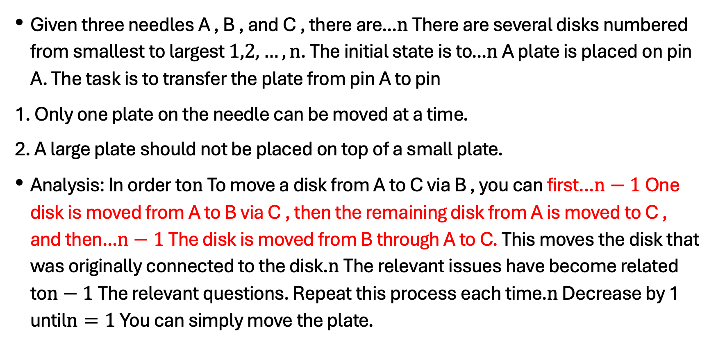
the Classic problem: The Tower of Hanoi
Given three needles A , B , and C , there are...$n$ There are several disks numbered from smallest to largest $1,2,…,n$. The initial state is to...$n$ A plate is placed on pin A. The task is to transfer the plate from pin A to pin
1. Only one plate on the needle can be moved at a time.
2. A large plate should not be placed on top of a small plate.
Analysis: In order to$n$ To move a disk from A to C via B , you can first...$n−1$ One disk is moved from A to B via C , then the remaining disk from A is moved to C , and then...$n−1$ The disk is moved from B through A to C. This moves the disk that was originally connected to the disk.$n$ The relevant issues have become related to$n−1$ The relevant questions. Repeat this process each time.$n$ Decrease by 1 until$n=1$ You can simply move the plate.

Slide 53
the Classic Problem: The Tower of Hanoi
Implementation of the Tower of Hanoi Problem
#include <bits/stdc++.h>
using namespace std;
void hanoi(int n, char a, char b, char c){
if ( ){
;
cout << a << " to " << c << endl;
;
}
}
int main(){
int n;
cin >> n;
hanoi(n, 'A', 'B', 'C');
return 0;
}
Notes:
n>0
hanoi (n-1,a,c,b)
hanoi (n-1,b,a,c);

Slide 54
Thank you everyone.
Note: Please turn off your microphone and camera.
Teacher Gao's Algorithm Competition Training Camp

